Slide 1
Year 11 & Sixth Form
Prayer & Liturgy
Wednesday 15th May
Delivered to you today
by St John Bosco’s Faith in Action Group

Slide 2
Since January when we began our Faith in Action group we have​
​
Read at feast day mass​
sung in the choir​
served at mass​
served at community mass in the prayer room​ for the public
baked biscuits for bake sale for lent charity​
performed in the passion​
attended choir lunchtime sessions​
Served refreshments and raised money for Cafod during ‘The Passion’ evening performance​
Attended the tree council training – caring for our common home 'Laudato Si’​ Pope Francis
Attended session 1. ‘we are loved’​
Attended session 2. ‘love your neighbour’​

Slide 3
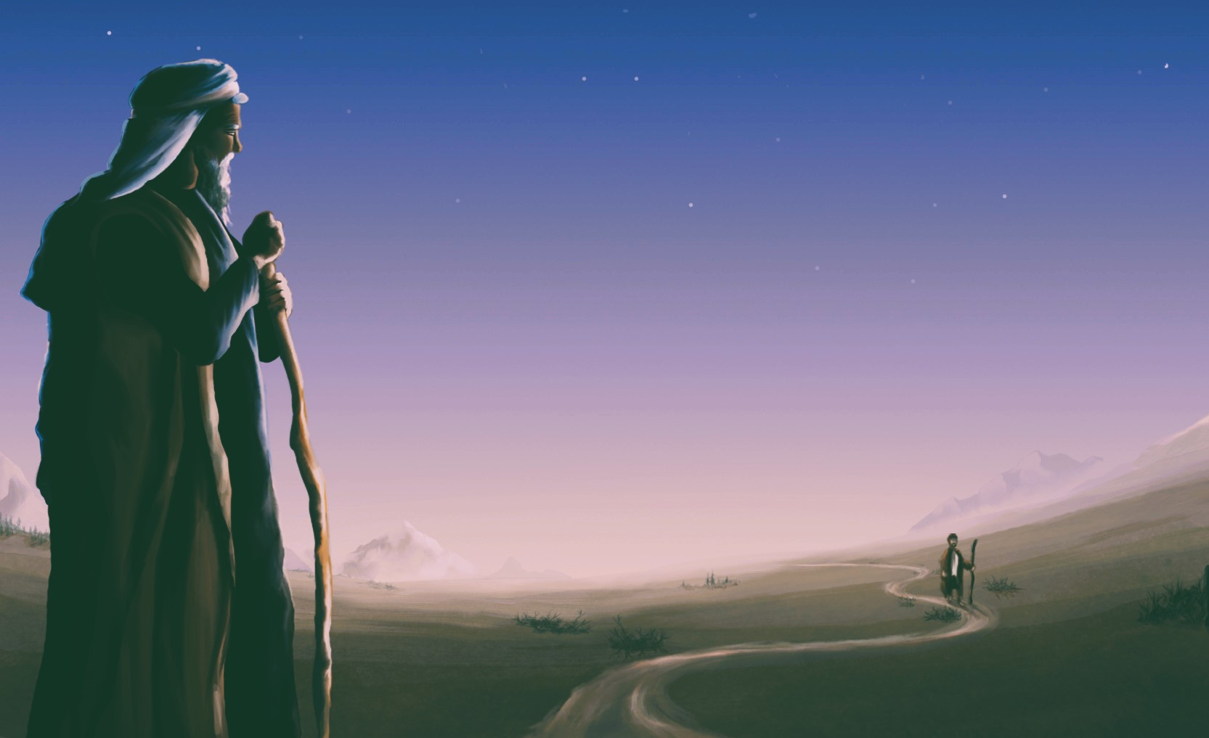
We have lots of ideas for future activities that will help our faith journey even more.
When we learn about people in the bible and people in our world today who have been serving others we are inspired to do the same.

Slide 4
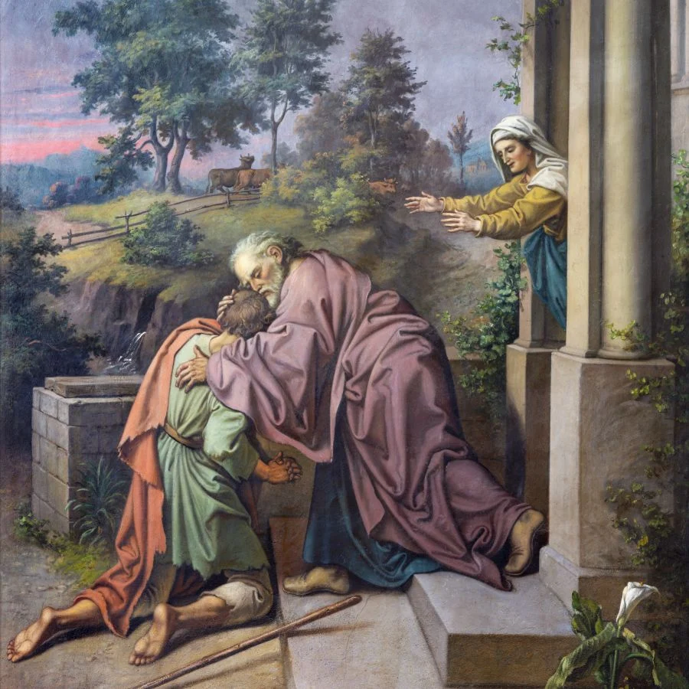
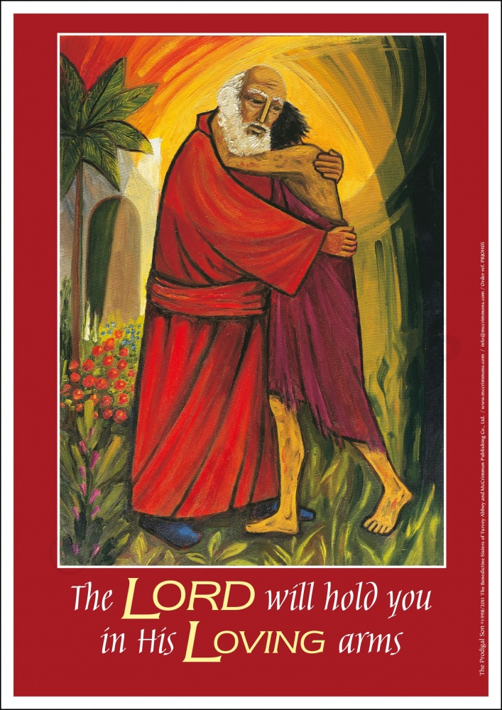
The message of the prodigal son

Slide 5
We have looked at some thought provoking questions on the question
’ We are loved’ …….
How do we know that God loves us?
Can you be commanded to love?
Can you be taught to love?
Does everyone deserve to be loved?
When is it difficult to love?
If you love someone, do they have to love you back?
We are loved, even when we do things wrong or have gone astray. God is there for us ready to greet us with arms wide open.

Slide 6
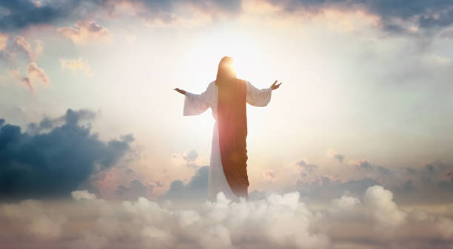
We have looked at some thought provoking questions on the question
’ Love thy neighbour’ …….
Can I love someone I don’t know?
Who is my neighbour?
How well do you know your physical neighbour?
Am I responsible for the well-being of people I don’t even know?
Does the way you love your neighbour affect your school/local/community/the world?
When did you last see Jesus in your neighbour?
Today, what stopped you from loving your neighbour?

Slide 7
So today we want you also to hear the message that we have been hearing….that You are loved and we wanted to tell you this today.
We wanted to tell you we want the best for you just as God does.
We wanted to tell you that even though we don’t know most of you that well …we share this place our common home and we learn to grow alongside each other. We are all here for a reason and we are all loved no matter what.

Slide 8
God our father, we pray for those who are a part of the exam season, we pray they are successful, and remind them Jesus is amongst them, and will offer support. We pray they don’t overwork, and remain faithful in these tough times. Glory to God Amen.

Slide 10
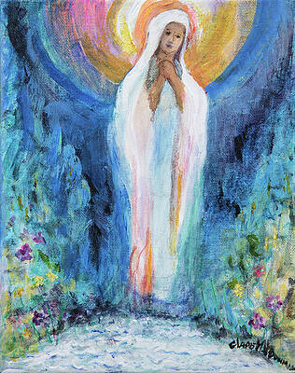
This week our prayer theme in school is about Mary, let us offer up all our prayers , worries and anxieties to her today as we listen to the prayer.

Slide 12
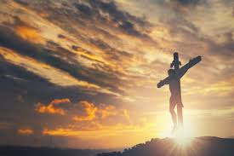
Dear God,
Bless all in my school this day
Give us hope for our future
And respect in our attitudes
Have love for ourselves and each other
May our community be a place of cheerfulness
Following the examples of St John Bosco
Amen.

Slide 13
God bless you as you journey through your exams and remember You are loved!

