Slide 1
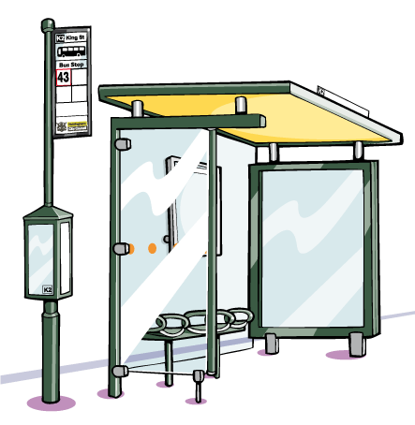
Division- the bus stop method

Slide 2
Warm up questions
10
5
7
6
4
5
4
7
6
4
3
7
7
3
3
8
9
12
9
5
12
9
4
5
12
8
12
12
11
11
30÷3=
25÷5=
42÷6=
18÷3=
24÷6=
15÷3=
28÷7=
49÷7=
36÷6=
16÷4=
24÷8=
21÷3=
14÷2=
12÷4=
36÷12=
56÷7=
81÷9=
72÷6=
90÷10=
40÷8=
48÷4=
63÷7=
32÷8=
20÷4=
60÷5=
64÷8=
108÷9=
144÷12=
121÷11=
110÷10=

Slide 3
159 ÷ 3
=53
0
5
3
3
1
1
5
9
1÷3=0 remainder 1
15÷3=5
9÷3=3

Slide 4
285 ÷ 5
=57
0
5
7
2
3
5
2
8
5
2÷5=0 r 2
35÷5=7
28÷5=5 r 3

Slide 5
288 ÷ 12
=24
0
2
4
2
4
12
2
8
8
48÷12=4
2÷12=0 r 2
28÷12=2 r 4

Slide 6
5.44 ÷ 4
=1.36
1
3
6
.
1
2
4
5
4
4
.
14÷4=3 r 2
5÷4=1 r 1
24÷4=6

Slide 7
27 ÷ 5
=5.4
0
5
4
.
2
2
5
2
7
0
.
20÷5=4
2÷5=0 r 2
27÷5=2 r 2

Slide 8
34 ÷ 8
=4.25
0
4
2
5
.
2
4
3
0
8
3
4
0
.
3÷8=0 r 3
34÷8=4 r 2
20÷8=2 r 4
40÷8=5

Slide 9
Practise Questions
A- I want to practise the “basics”
284÷4
201 ÷ 3
612÷12
504÷7
294÷7
335÷5
329÷7
957÷11
522÷6
712÷8
B- I want practise working with decimals
98÷8
65÷4
14÷5
194÷8
145÷4
119.9÷7
138.6÷9
108.5÷5
356.4÷11
195.9÷3
=71
=67
=51
=72
=82
=67
=47
=87
=87
=89
C- I want a challenge
432÷18
465÷15
529÷23
966÷23
864÷27
575÷25
924÷28
544÷16
665÷19
756÷18
=12.25
=16.25
=2.8
=24.25
=36.25
=16.7
=15.4
=21.7
=32.4
=65.3
=24
=31
=23
=42
=32
=23
=33
=34
=35
=42

